Slide 1
Milky Way Rotation Curve
Sam Grobelny, Sacha Wible, Wentao Zhong

Slide 2
Methods & Assumptions
R ≤ 30 kiloparsecs
Bulge
M = 10^10 solar masses
1≤ R ≤ 30 kiloparsecs
Disk, approximated as a disk
M = 10^11 solar masses
1 ≤ R ≤ 10 kiloparsecs
Calculations
Orbital velocity = √(GM/R)
Enclosed mass of disk = π * R^2 * density

Slide 3
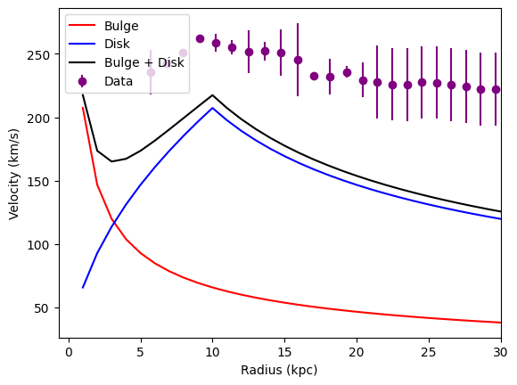
The Graph
using the assumed values and approximations we find this graph
data
measuring the rotational velocity of M31
comparable to the Milky Way under radius of 50KPC
comparing our approximations with the collected data we appear to be missing something

Slide 4
Methods & Assumptions 2
Halo, approximated as a sphere
M = 10^12 solar masses
1 ≤ R ≤ 30 kiloparsecs
Calculations
Volume of sphere = 4/3 * π * R^3
Enclosed mass of sphere = 4/3 * π * R^3 * density

Slide 5
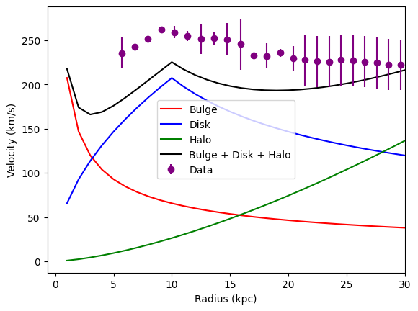
The Final Graph (With Data)
includes the halo, which is not classically observable
indicates dark matter, as the rotational curve better matches the collected data when dark matter is accounted for

Slide 6
Works Cited
Carignan, Claude, et al. “The extended HI rotation curve and mass distribution of M31.” The Astrophysical Journal, vol. 641, no. 2, 30 Mar. 2006, https://doi.org/10.1086/503869.

